Slide 1
COMMON GROUND_
LARGE AREA STERILIZATION MACHINE

Slide 2
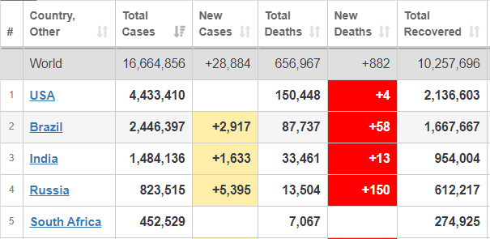
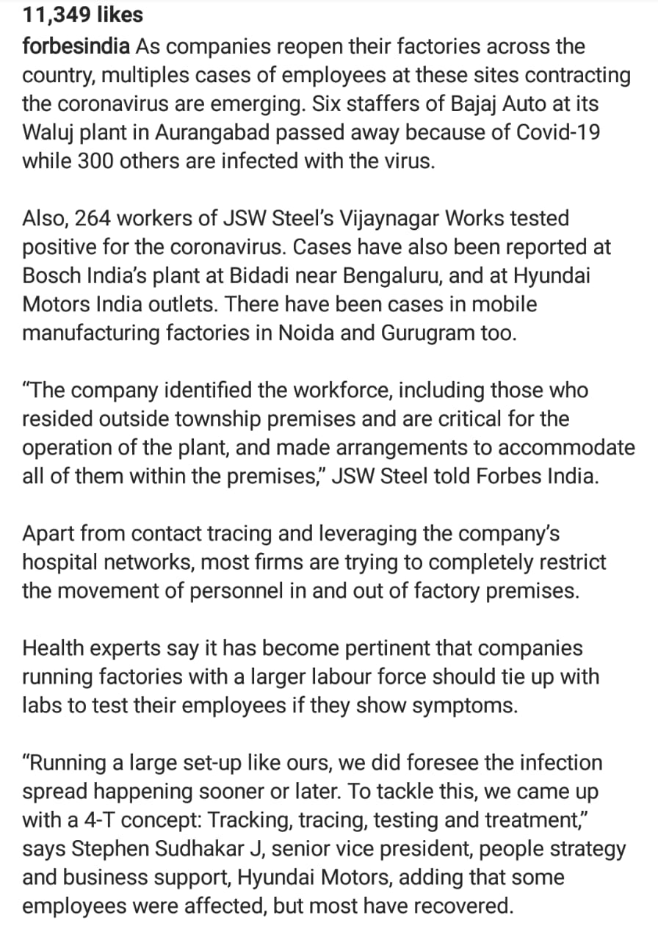
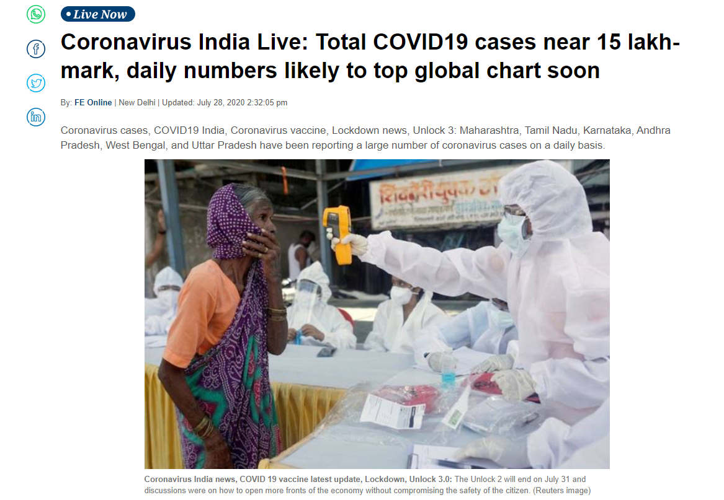

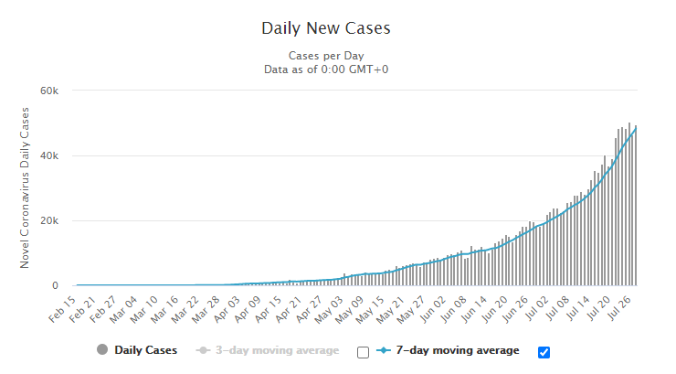
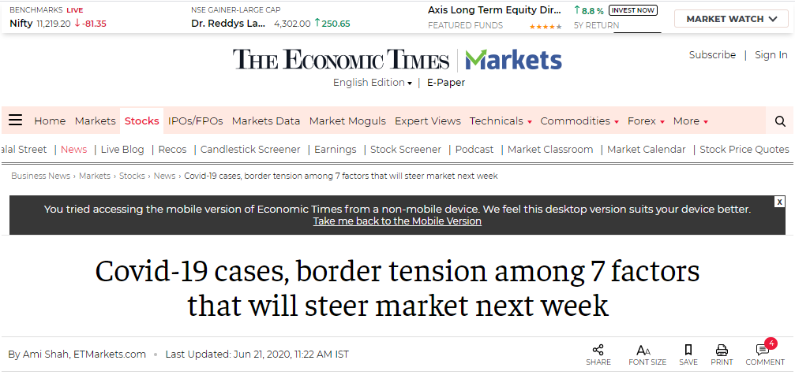
CURRENT SCENARIO

Slide 3
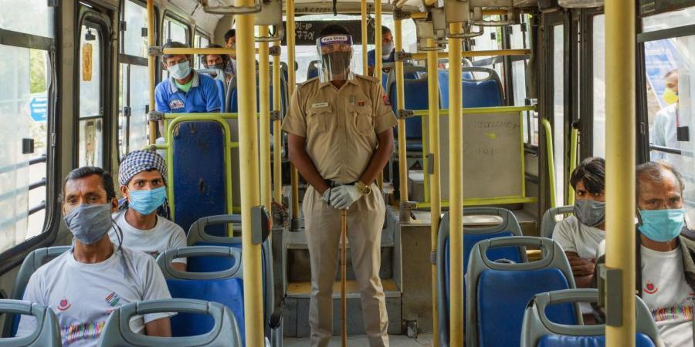
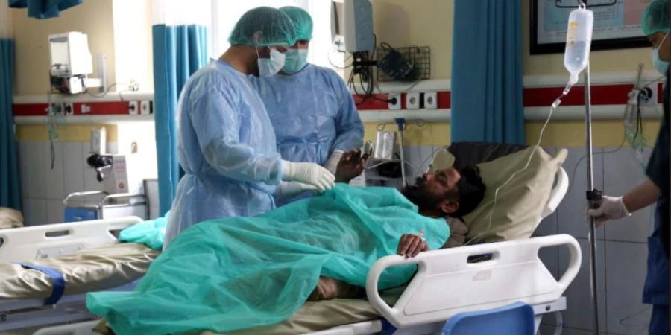
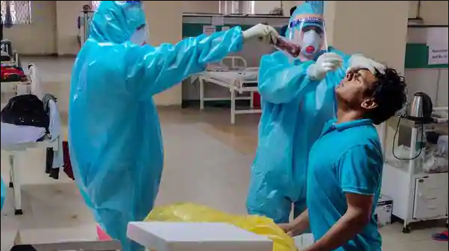
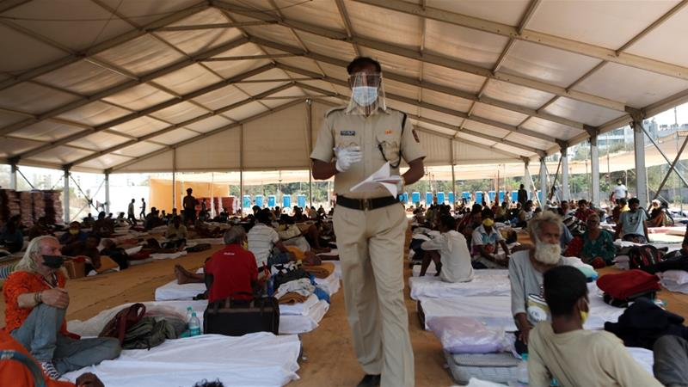
WHY?
PUBLIC TRANSPORT AND PLACES
HOSPITAL
QUARANTINE CENTRE
nCOV TEST CENRES

Slide 4
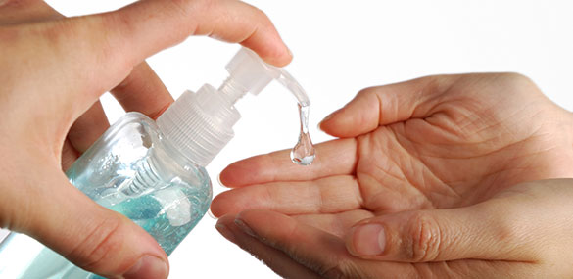
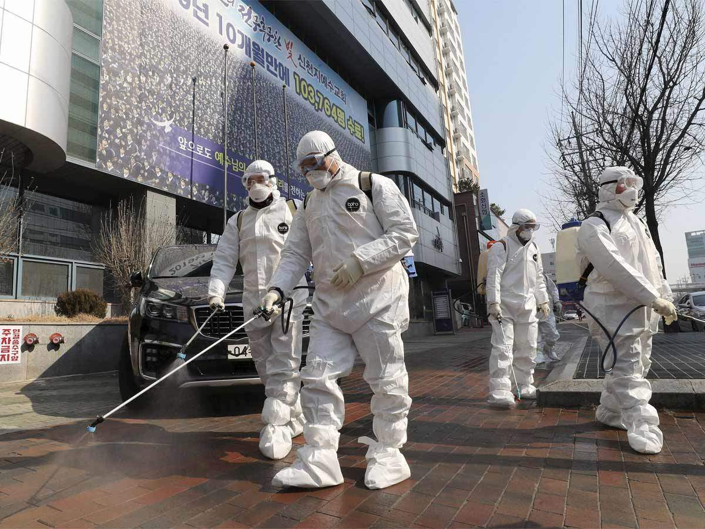
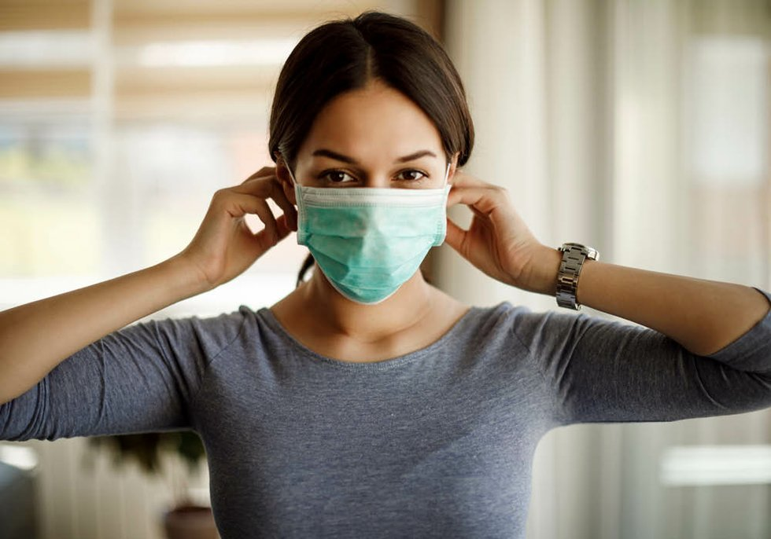
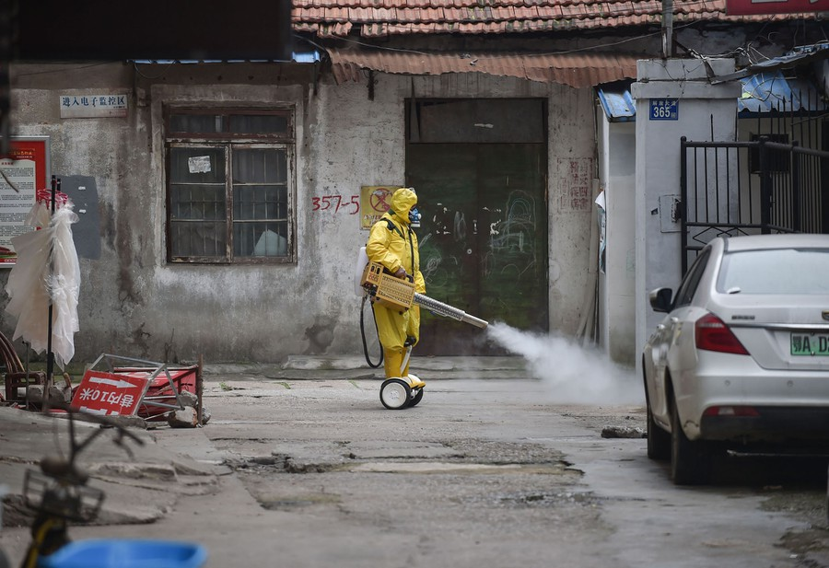

CONTROL IT !

Slide 5
The Problem
LARGE
AREA
STERILIZATION

Slide 6
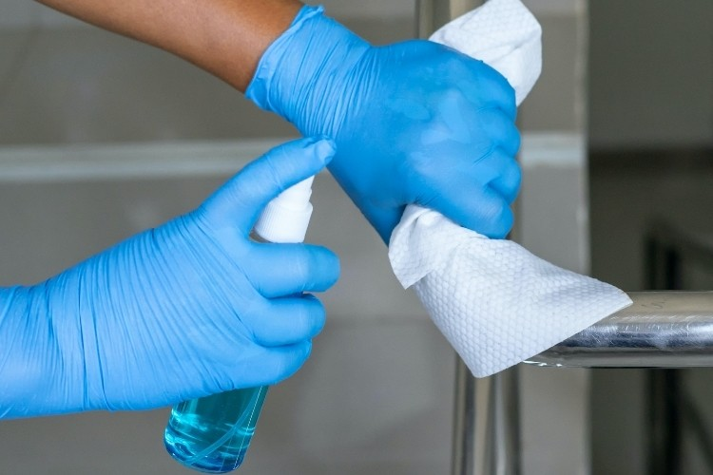
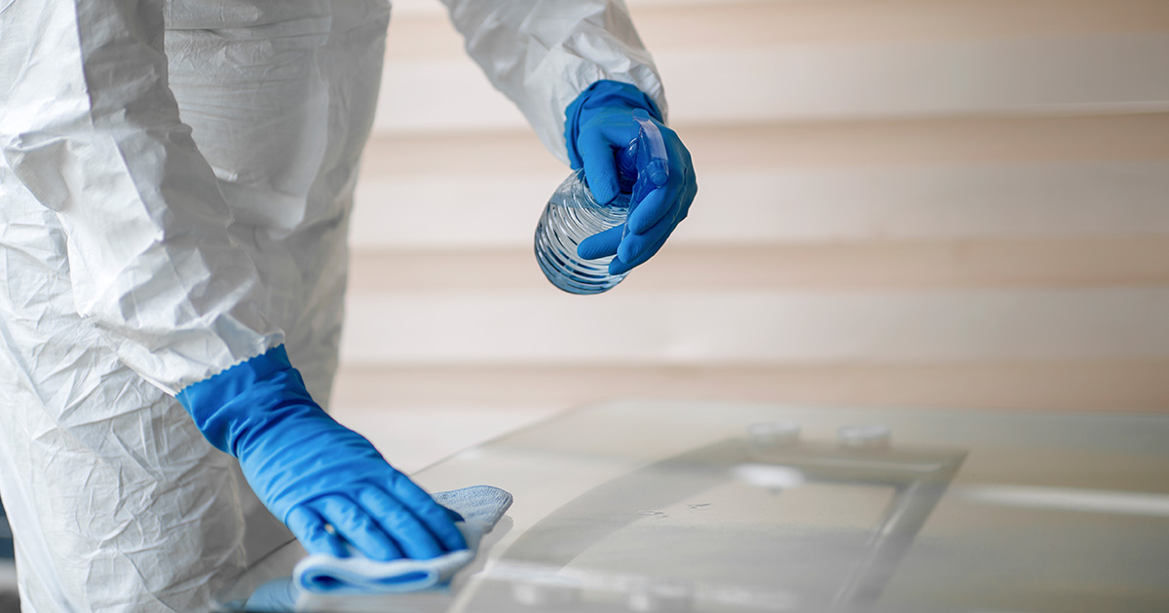
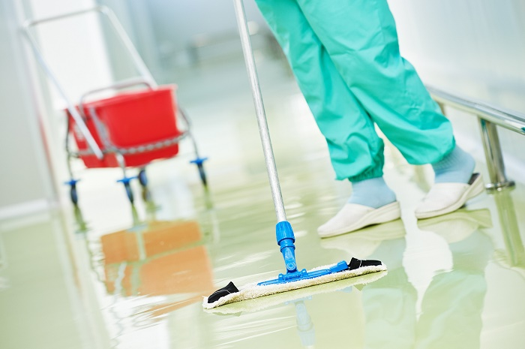
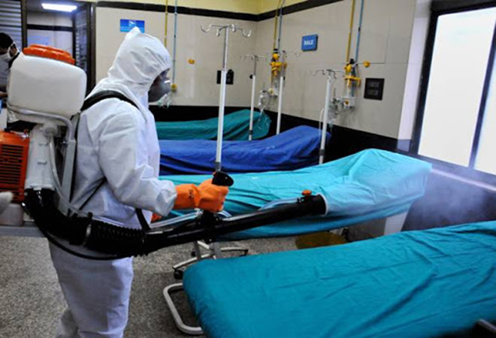
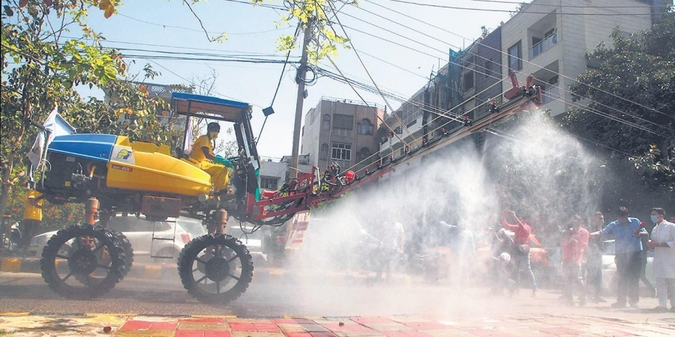
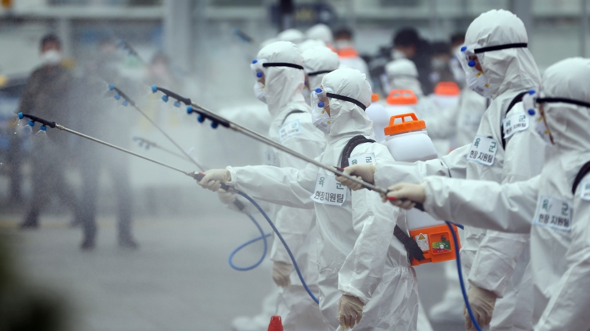
HOW IS IT DONE RIGHT NOW?

Slide 7
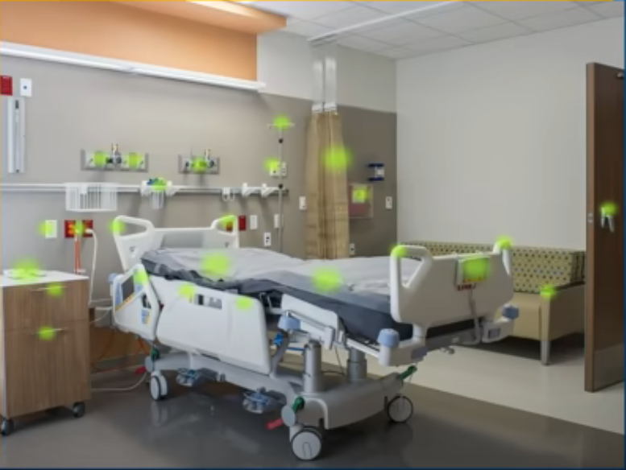
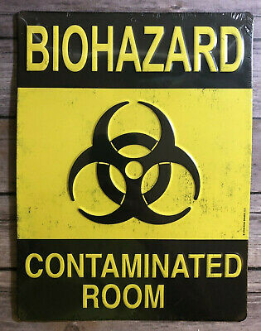

Manual Sterilization by House Keeper or Health Worker
According to studies in early 2000

Slide 8
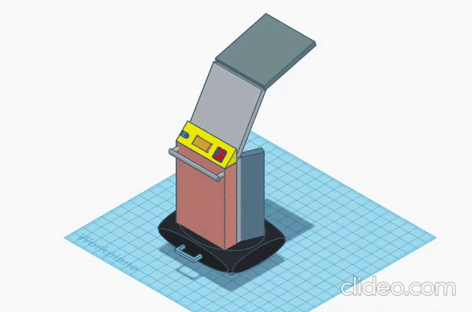
OUR
SOLUTION
UVC Based Large Area Sterilization Machine

Slide 9
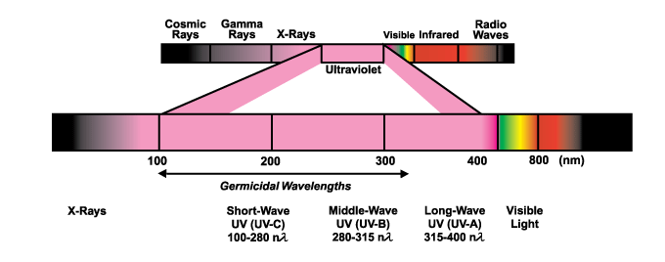
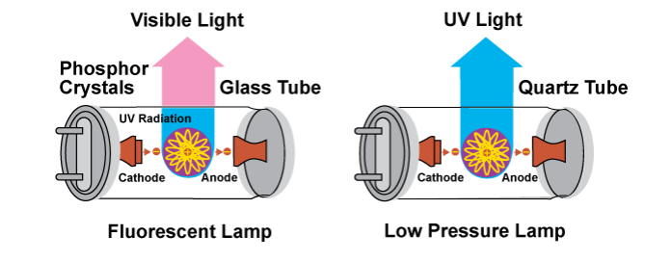
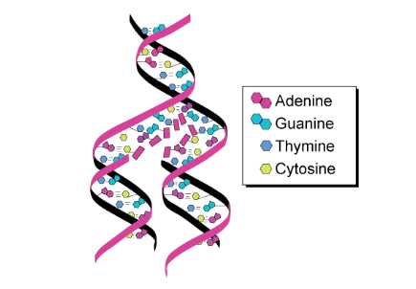
What | Why | How deep UV or UVC ?
Lamp wavelength | 254 nanometers
Irradiance intensity | 15.4mW/cm²
Distance with medium | 25.4mm
Period of exposure | 5s
Deactivation rate | 99.9%
Medium of sterilization | Air, water, solid surface
UV-C light is germicidal – i.e., it deactivates the DNA of bacteria, virus and other pathogens and thus destroys their ability to multiply and cause disease.

Slide 10

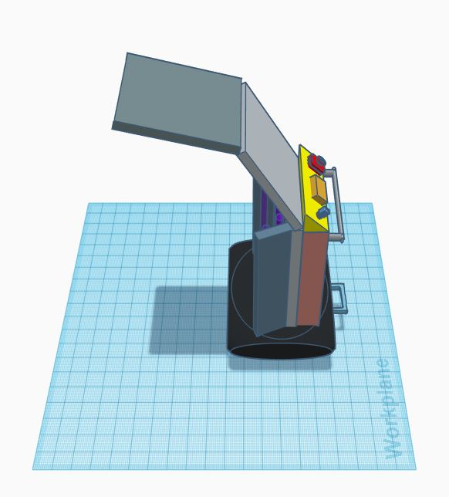
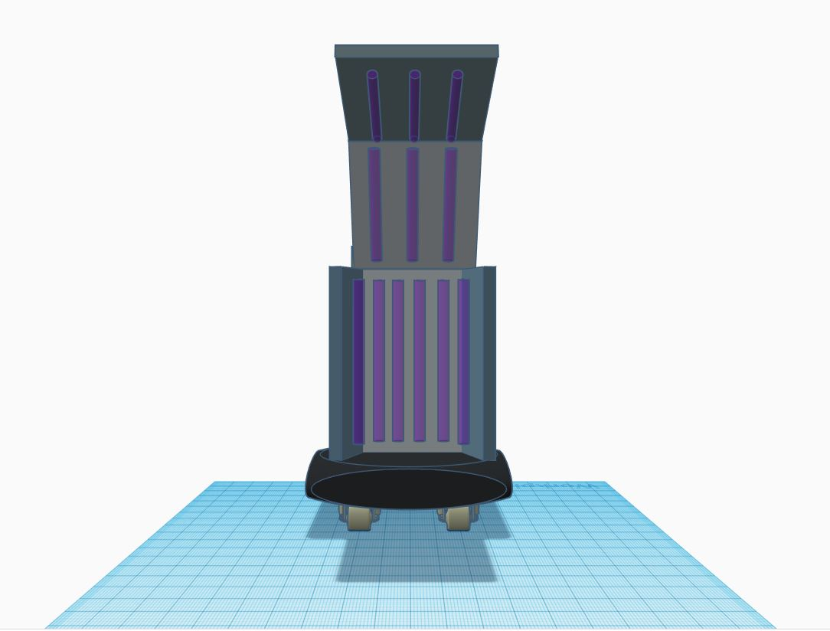

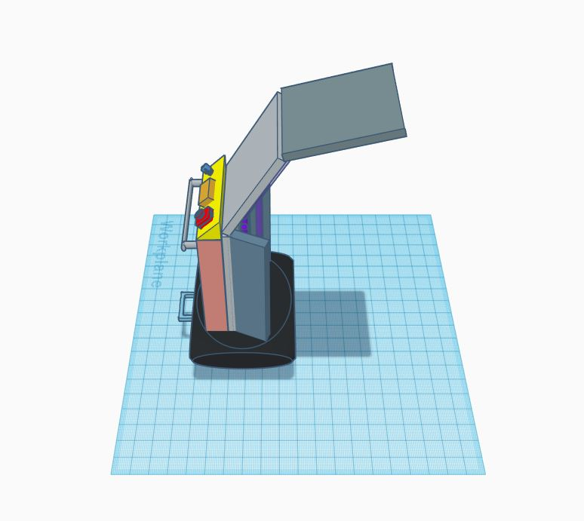
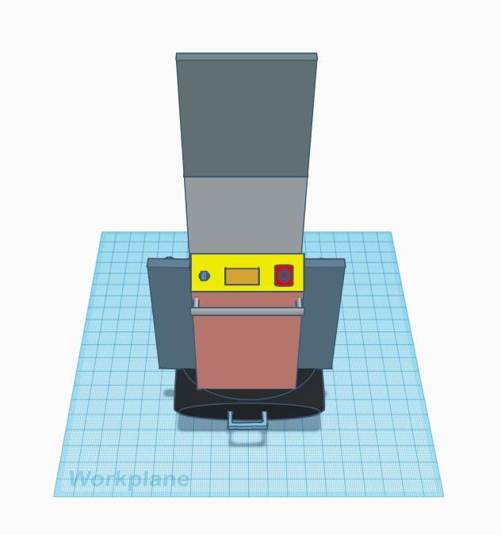
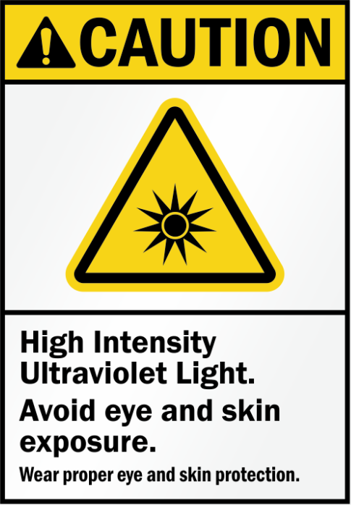
Features & Specifications

Slide 11
Features & Specifications
The PoLaAr Mode
Portable Large Area Mode
Medical Ward
Quarantine Center
Contaminated Zone Rooms
Public Transport Station
Offices

Slide 12
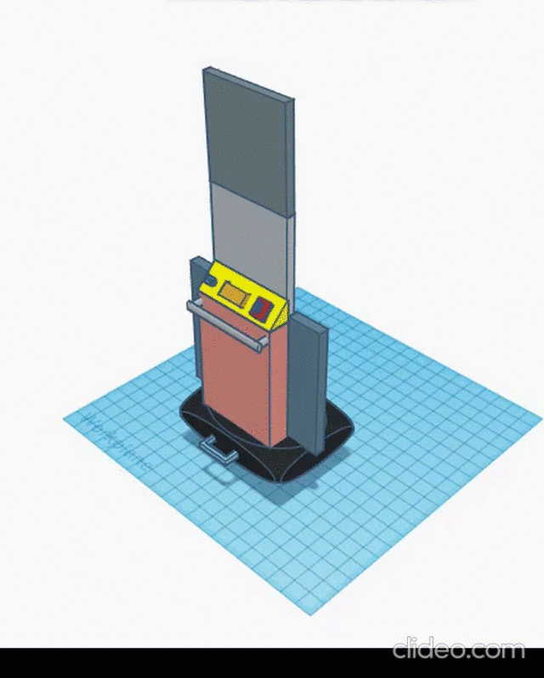
Features & Specifications
The SaLaAr Mode
Static Large Area Mode
Large amount PPE Kit Sterilization
Contaminated lobby and corridor sterilization
Much more

Slide 13
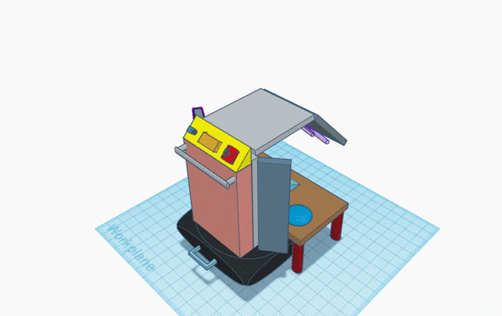
Features & Specifications
The Box Mode
Small object sterilization
Quick sterilization

Slide 14
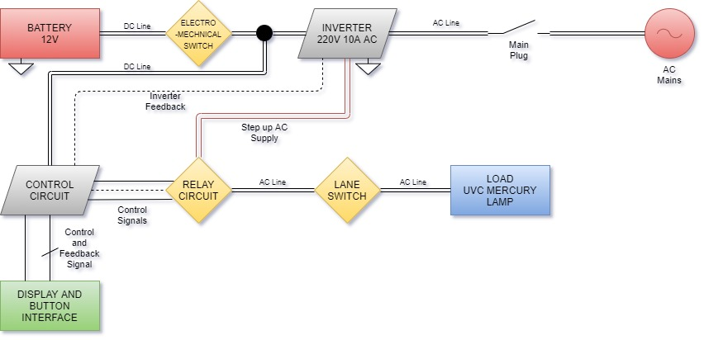
Features & Specifications
INTERNAL SYSTEM BLOCK DIAGRAM

Slide 15
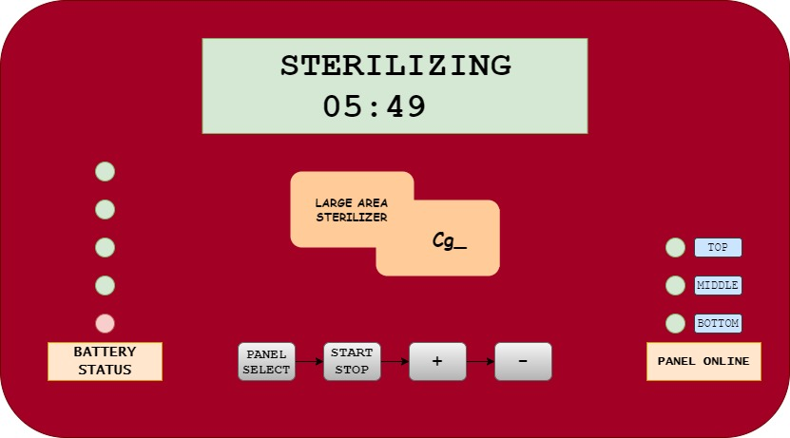
Features & Specifications
CONTROL PANEL

Slide 16
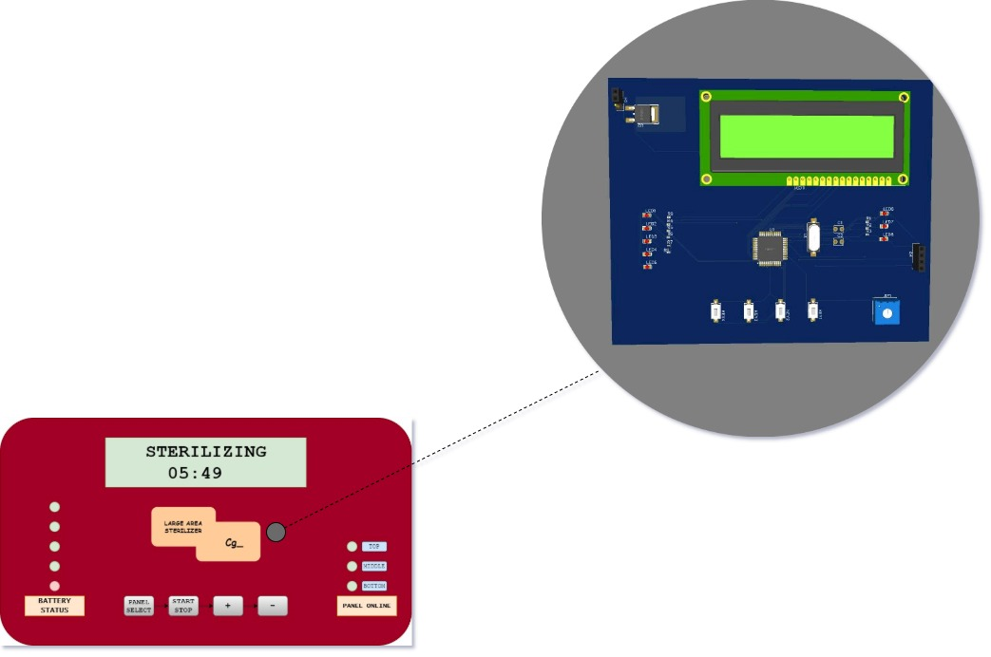
Features & Specifications
CONTROL PANEL INSIDER

Slide 17
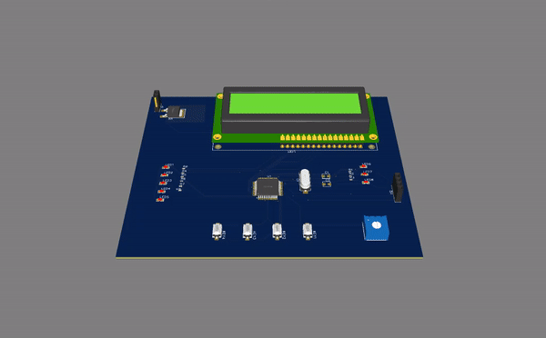
Features & Specifications
CONTROL PANEL INSIDER
16x2 8 bit LCD
LED Array for Battery Level
LED Array for Panel Online
ADC for Battery Status Read
Buttons for Manupulation
16 Bit MCU
O/P Signal to Relay Board

Slide 18
Features & Specifications
POWER CIRCUIT

Slide 19
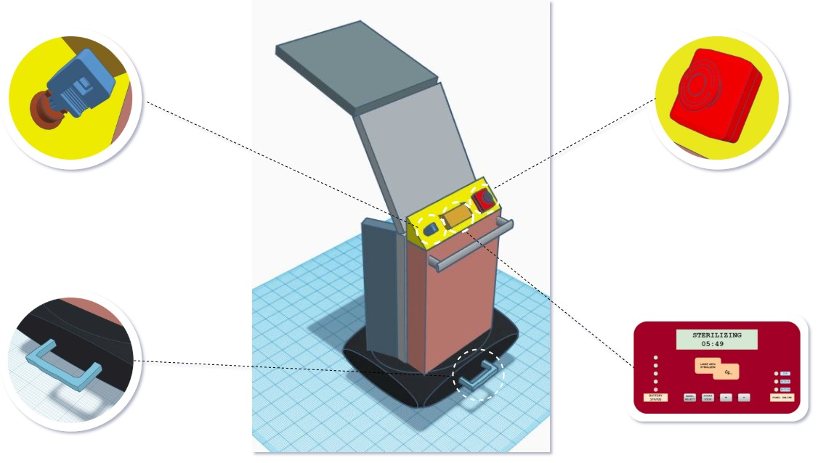
Operation Overwiew
System Lock
Emergency
Switch
Control Panle
Bump Lifter

Slide 20
BOTTOM LINE
“Let's defeat the invisible enemy with invisible powers!”
“ They Believe Us!”

